Slide 1
Airport Delay
Project 7

Slide 2
Overview
Objective
Data Set
% Delay Gate arrivals
Top 4 airports
Top 3 characteristics
PCA

Slide 3
Problem/Objective
Problem
FAA wants to decrease delays at airports
Objective
Discover which characteristics are the main cause for delays
Locate airports with the most characteristics
Use PCA to find new features

Slide 4
Data Set
2 tables (join = Inner, on = airport & year)
Airport_cancellations.csv
Airport_operations.csv
# of rows = 799
New column
% delay gate arrivals = 1- percent on-time gate arrivals

Slide 5
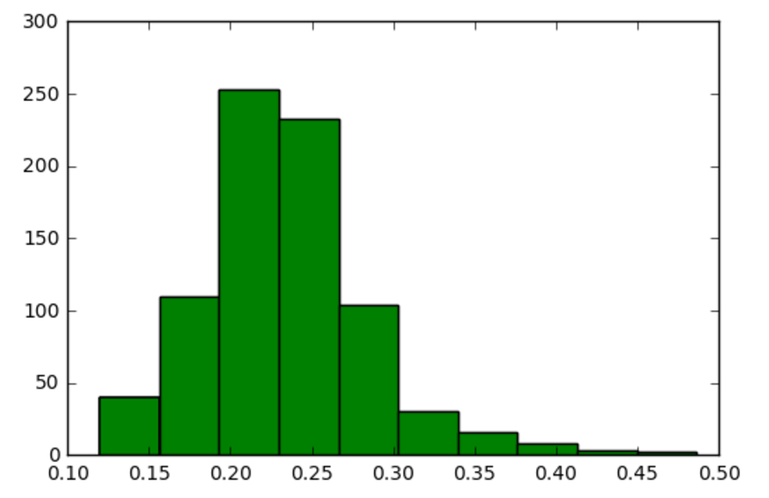
% delay gate arrivals

Slide 6
Correlation
Characteristics are the main cause for delays
(% delay gate arrivals) Correlation
average_gate_departure_delay | 0.800603
average airport departure delay | 0.712975
average block delay | 0.55001
average taxi out delay | 0.287357
average airborne delay | 0.27124
average_taxi_out_time | 0.230311
Departure Cancellations | 0.113363
Arrival Cancellations | 0.09413
average taxi in delay | 0.087212
Arrival Diversions | 0.028064
airport | -0.002305
Departure Diversions | -0.067575
year | -0.135191
percent on-time airport departures | -0.695697
percent on-time gate departures | -0.782703

Slide 7
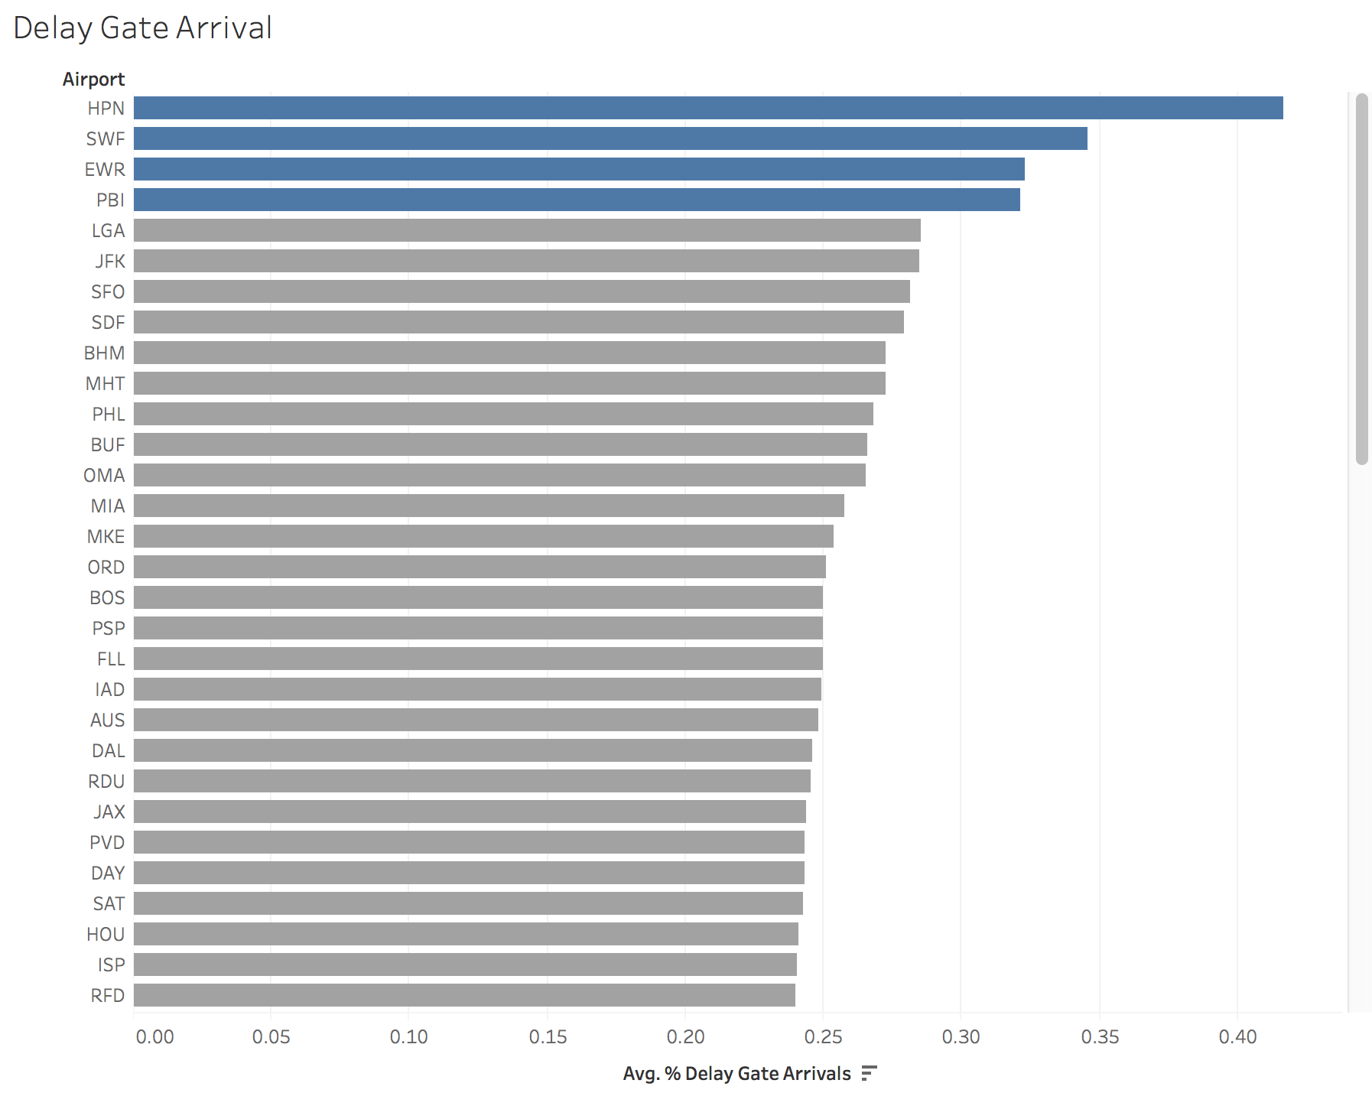
Top 4 Airports

Slide 8
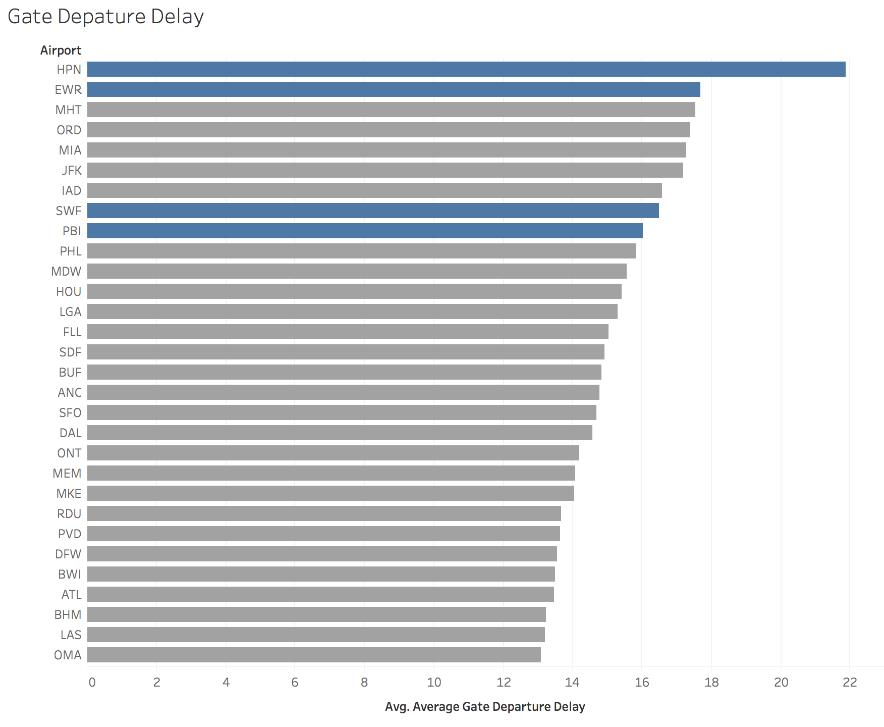
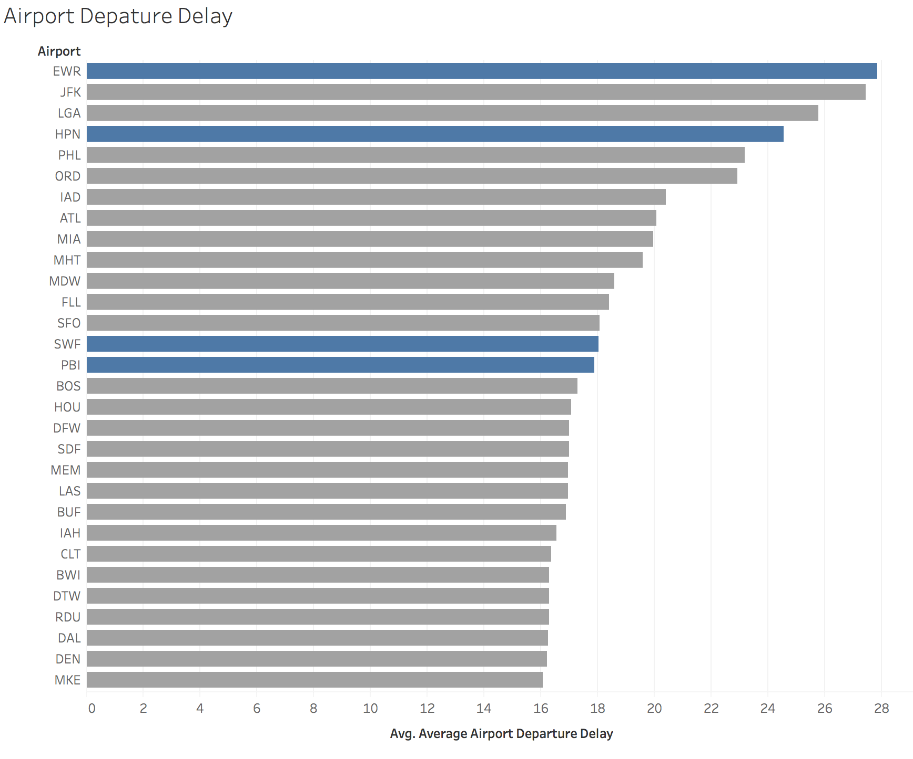
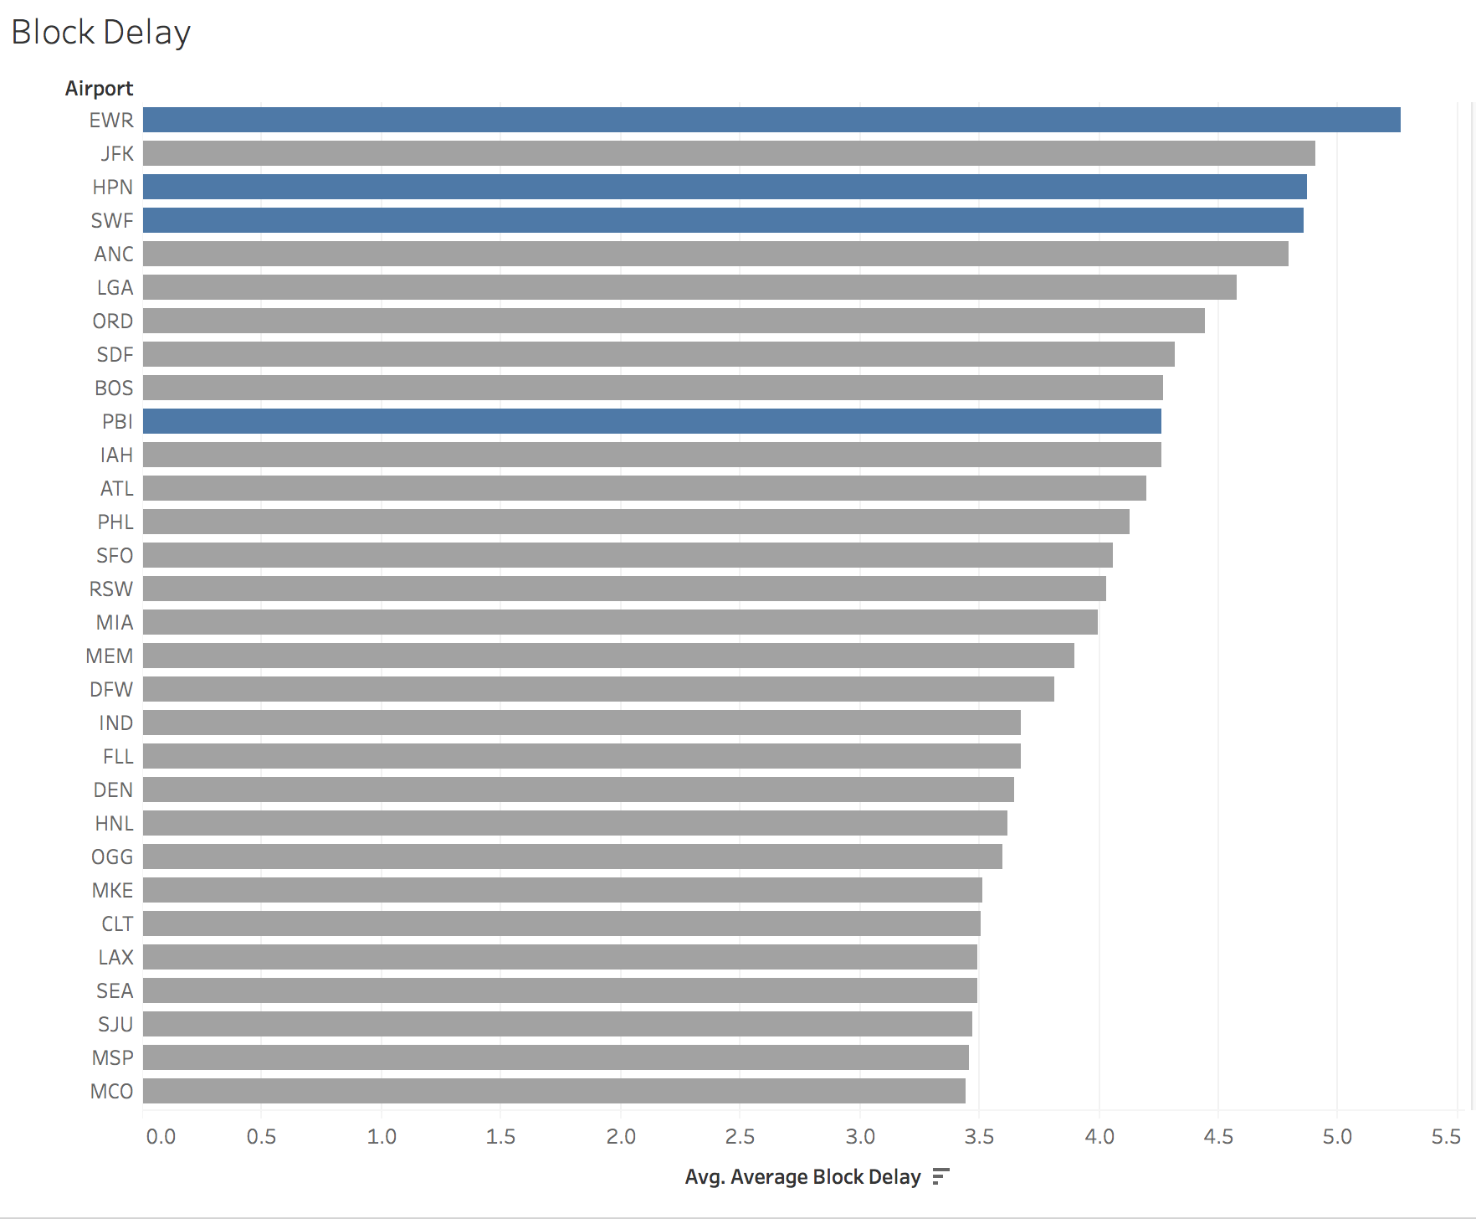
Top 3 Characteristics
(% delay gate arrivals) Correlation
average_gate_departure_delay | 0.800603
average airport departure delay | 0.712975
average block delay | 0.55001

Slide 9
Top 3 Characteristics
(% delay gate arrivals) Correlation
average_gate_departure_delay | 0.800603
average airport departure delay | 0.712975
average block delay | 0.55001

Slide 10
PCA
pcask = PCA(n_components=3)
y_sk = pcask.fit_transform(x_standard)
importance of each feature =
[-0.04651542, -0.22554881, -0.31261293, -0.22767956, 0.26086175,
0.26080009, 0.27292699, 0.3212791 , 0.21069429, 0.23286952,
0.24772497, 0.27611479, 0.23734901, 0.23329152, 0.19512492,
0.21616139, 0.22767956])
% explained [ 0.50181623, 0.23054045, 0.08420341])

